Slide 1
Learning Objective
I will be able to interpret and use logarithmic scales
Success Criteria
At the end of the lesson, I will be able to:
4.1.4 Interpret and use logarithmic scales
4.1.8 Identify contexts suitable for modelling by logarithmic functions and use them to solve
practical problems

Slide 2
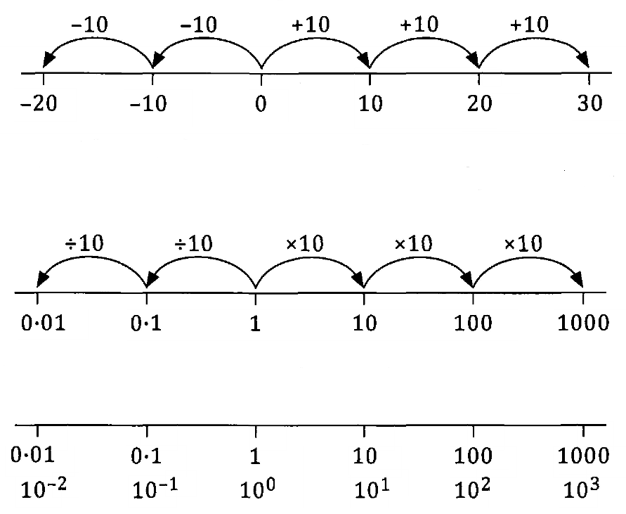
Logarithmic Scales
In linear equations, the first difference pattern is always the increasing or decreasing at a constant rate. We either subtract or add a constant amount each time to achieve the next value in our scale.
In logarithmic scales, if we move a particular distance to the right or left, we multiply or divide by the same amount. In the case of base-10 values, each time we multiply or divide by 10, we are moving one unit across.
Given that in a logarithmic scale, we can display a greater range of values, going into the 100 000s and onwards, these scales are useful when we make large measurements. A few of their applications are in Richter scales, music scales, loudness measurements and pH scales.

Slide 3
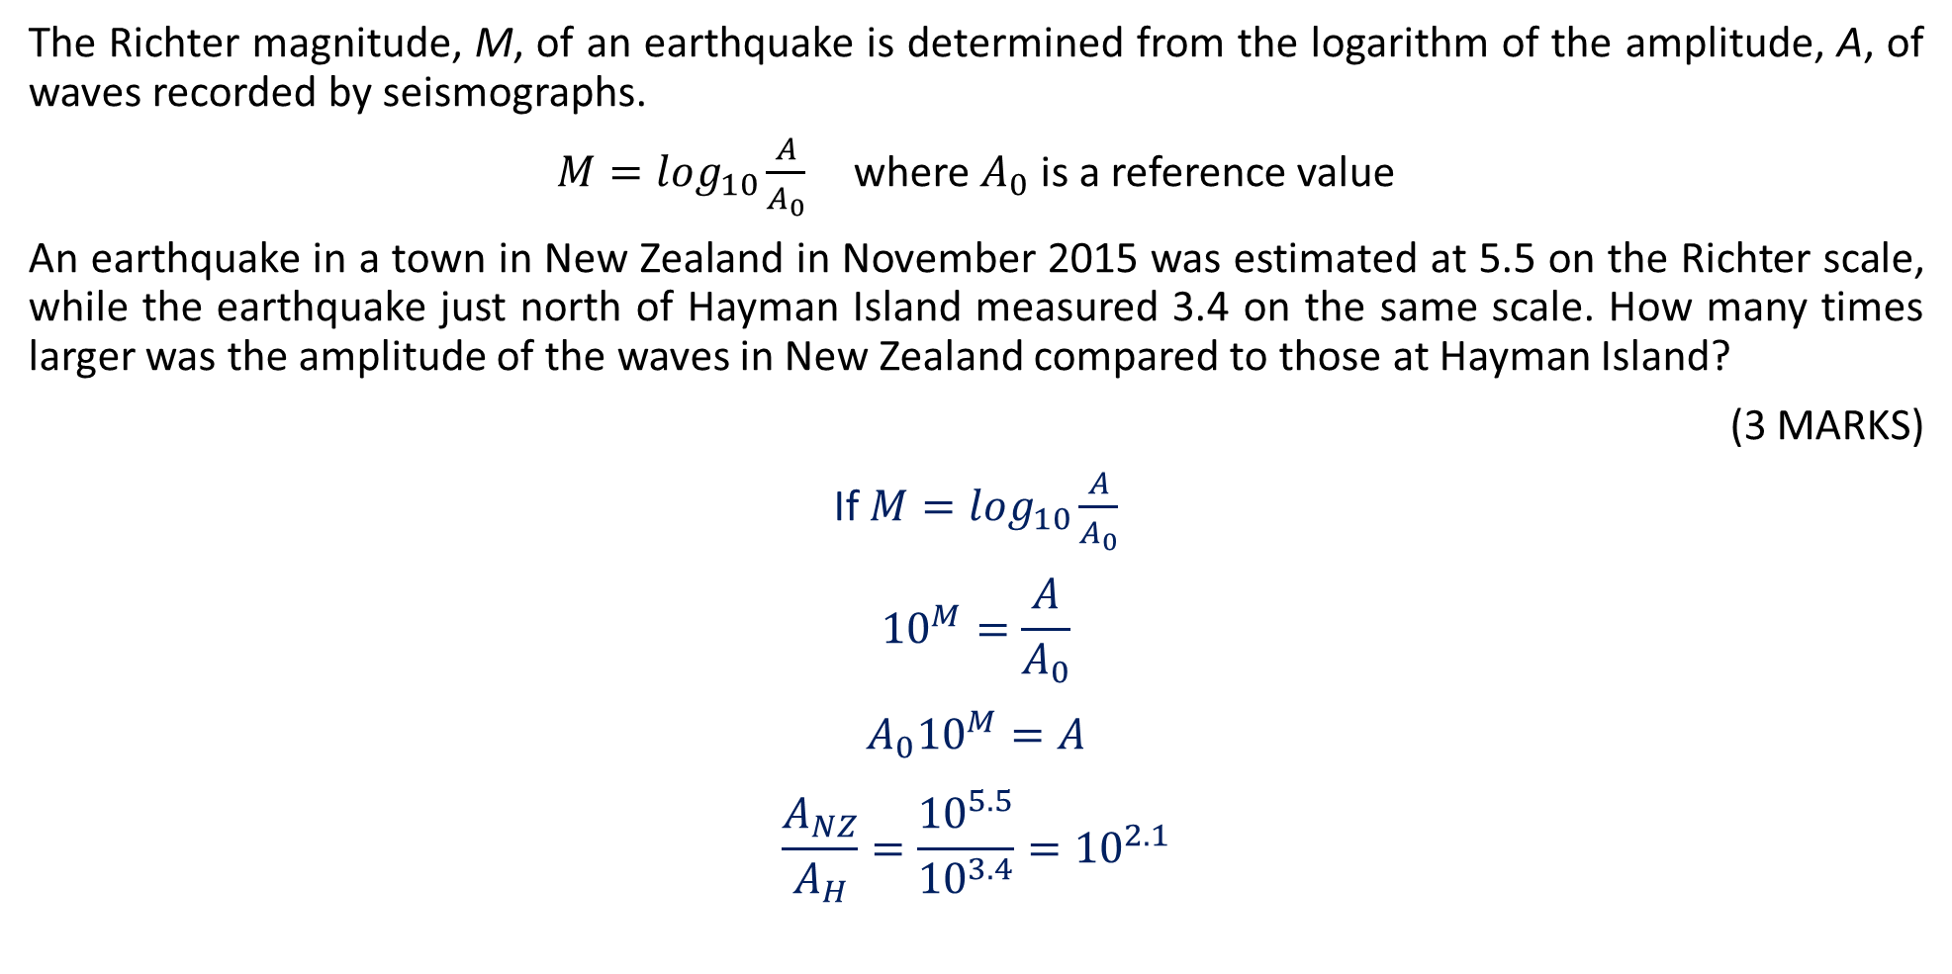
Guided Practice
The Richter magnitude, M, of an earthquake is determined from the logarithm of the amplitude, A, of waves recorded by seismographs.
$M=\log_{10}\frac{A}{A_{0}}$ where $A_{0}$ is a reference value
An earthquake in a town in New Zealand in November 2015 was estimated at 5.5 on the Richter scale, while the earthquake just north of Hayman Island measured 3.4 on the same scale. How many times larger was the amplitude of the waves in New Zealand compared to those at Hayman Island?
(3 MARKS)
If $M=\log_{10}\frac{A}{A_{0}}$
$${10}^{M}=\frac{A}{A_{0}}$$
$${A_{0}10}^{M}=A$$
$$\frac{A_{NZ}}{A_{H}}=\frac{{10}^{5.5}}{{10}^{3.4}}={10}^{2.1}$$
✓ Converts log statement to an index form
✓ Subtracts Richter magnitudes
✓ Determines ratio of amplitudes

Slide 4
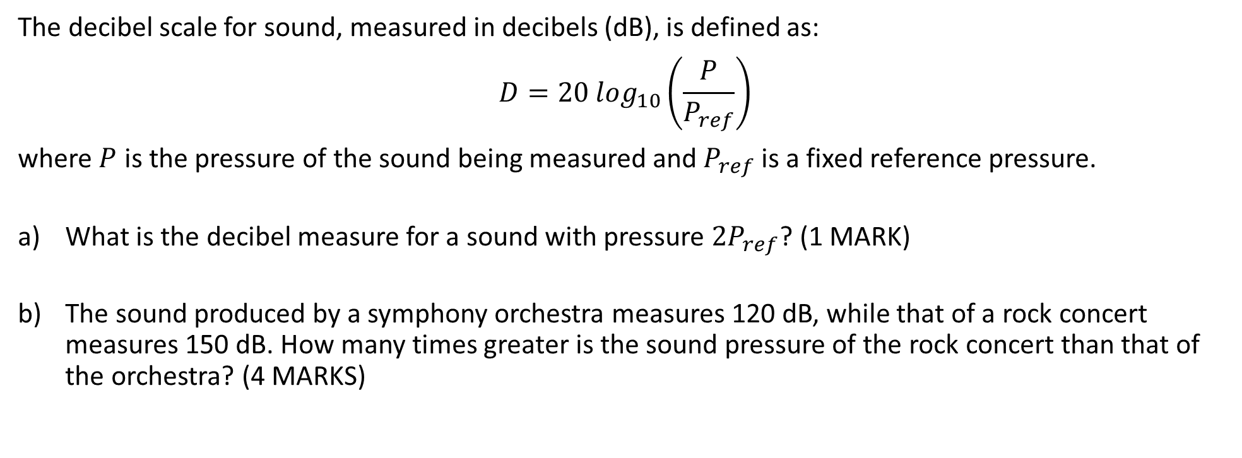
Guided Practice
The decibel scale for sound, measured in decibels (dB), is defined as:
$$D=20 \log_{10}\left(\frac{P}{P_{ref}}\right)$$
where $P$ is the pressure of the sound being measured and $P_{ref}$is a fixed reference pressure.
What is the decibel measure for a sound with pressure ${2P}_{ref}$? (1 MARK)
The sound produced by a symphony orchestra measures 120 dB, while that of a rock concert measures 150 dB. How many times greater is the sound pressure of the rock concert than that of the orchestra? (4 MARKS)

Slide 5
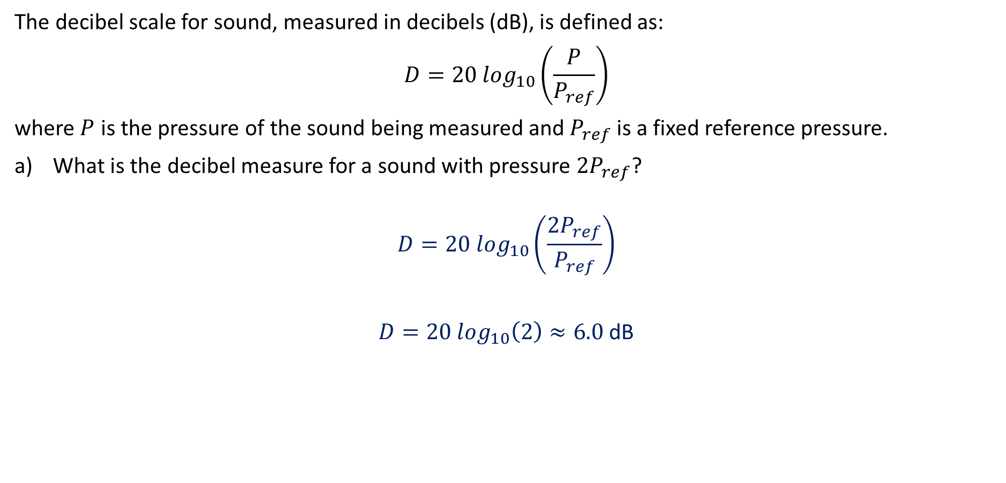
Guided Practice
The decibel scale for sound, measured in decibels (dB), is defined as:
$$D=20 \log_{10}\left(\frac{P}{P_{ref}}\right)$$
where $P$ is the pressure of the sound being measured and $P_{ref}$is a fixed reference pressure.
What is the decibel measure for a sound with pressure ${2P}_{ref}$?
$$D=20 \log_{10}\left(\frac{2P_{ref}}{P_{ref}}\right)$$
$D=20 \log_{10}\left(2\right)≈6.0$ dB
✓ Correctly calculates the decibel measure

Slide 6
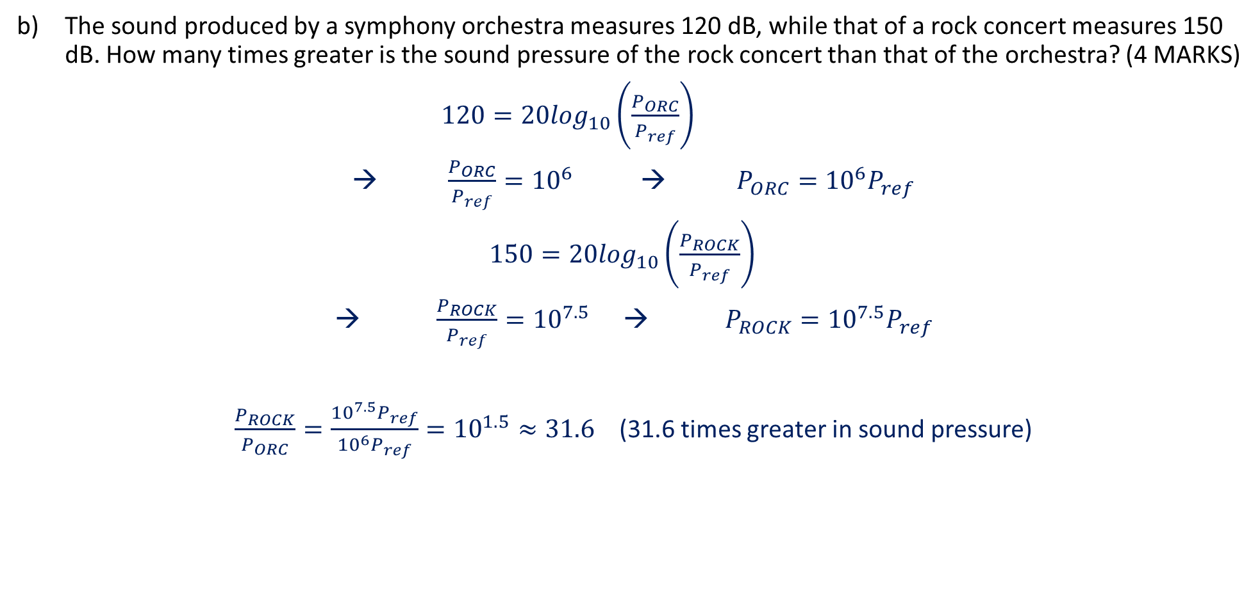
Guided Practice
The sound produced by a symphony orchestra measures 120 dB, while that of a rock concert measures 150 dB. How many times greater is the sound pressure of the rock concert than that of the orchestra? (4 MARKS)
$120=20\log_{10}\left(\frac{P_{ORC}}{P_{ref}}\right)$
→ $\frac{P_{ORC}}{P_{ref}}={10}^{6}$ → $P_{ORC}={10}^{6}P_{ref}$
$150=20\log_{10}\left(\frac{P_{ROCK}}{P_{ref}}\right)$
→ $\frac{P_{ROCK}}{P_{ref}}={10}^{7.5}$ → $P_{ROCK}={10}^{7.5}P_{ref}$
$\frac{P_{ROCK}}{P_{ORC}}=\frac{{10}^{7.5}P_{ref}}{{10}^{6}P_{ref}}={10}^{1.5}≈31.6$ (31.6 times greater in sound pressure)
✓ States the equations to each concert in logarithmic form
✓ Simplifies the equations using log laws to solve for the sound pressure of each concert
✓ Takes the ratio and cancel P_{ref}
✓ Determines how many more times greater the sound pressure is

Slide 7
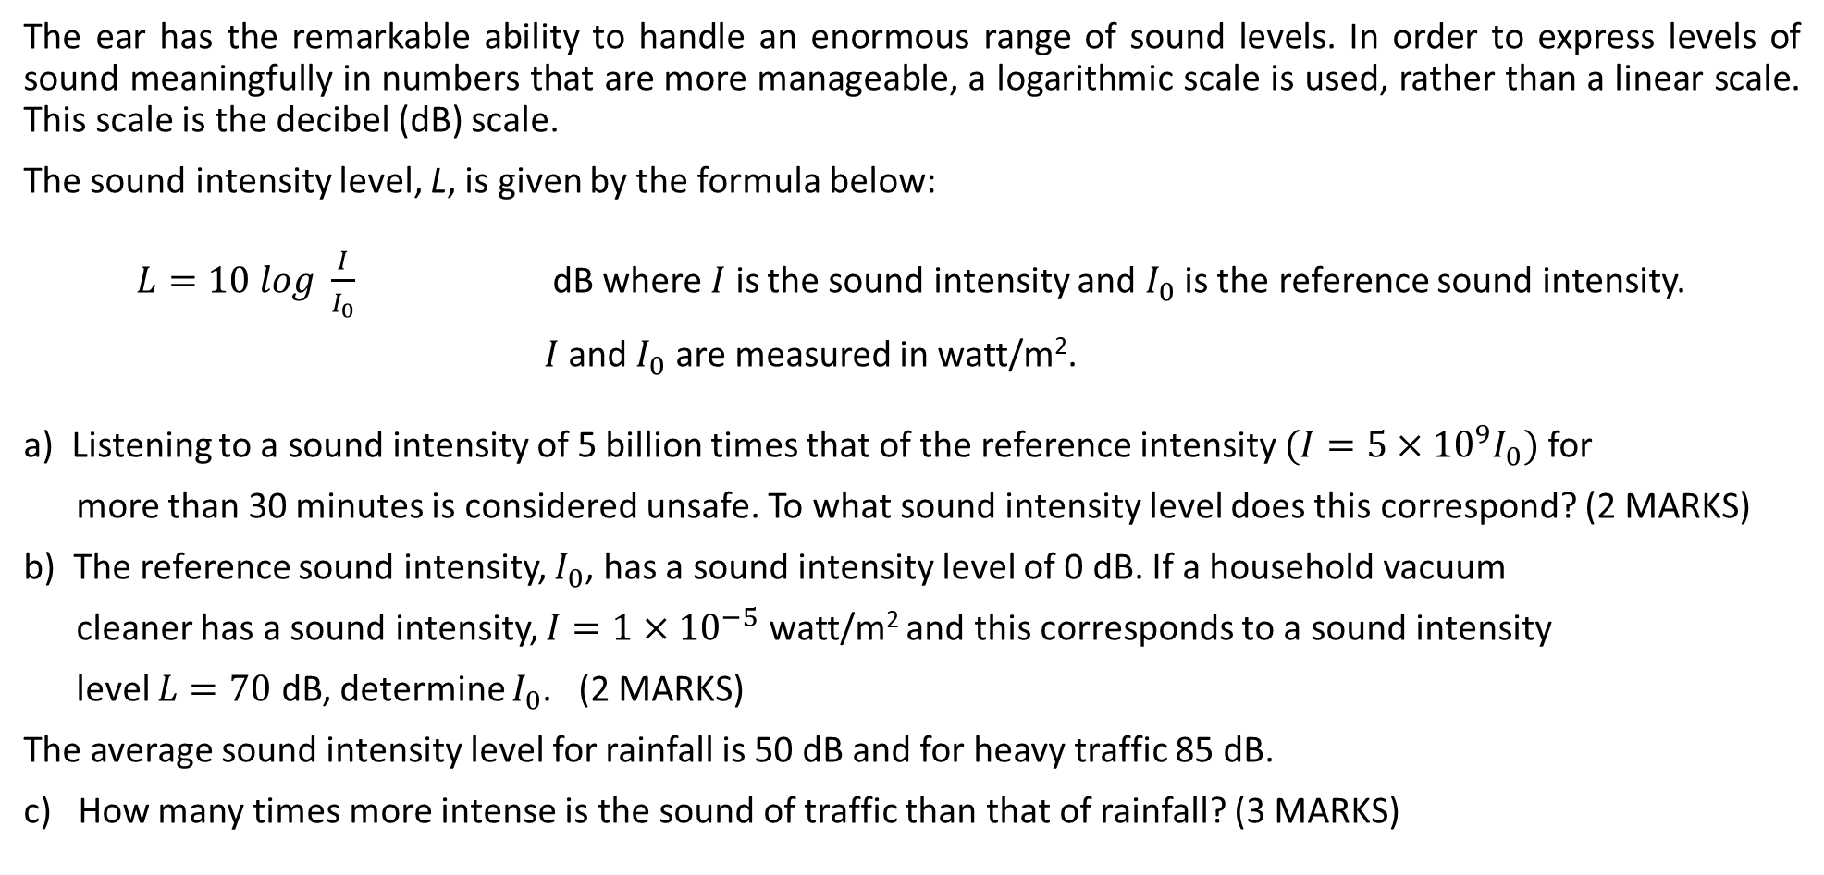
2018 WACE Calc-Assumed (Q18 - 7marks)
The ear has the remarkable ability to handle an enormous range of sound levels. In order to express levels of sound meaningfully in numbers that are more manageable, a logarithmic scale is used, rather than a linear scale. This scale is the decibel (dB) scale.
The sound intensity level, L, is given by the formula below:
$L=10 log \frac{I}{I_{0}}$ dB where $I$ is the sound intensity and $I_{0}$ is the reference sound intensity.
$I$ and $I_{0}$ are measured in watt/m².
a) Listening to a sound intensity of 5 billion times that of the reference intensity $(I=5×{10}^{9}I_{0})$ for
more than 30 minutes is considered unsafe. To what sound intensity level does this correspond? (2 MARKS)
b) The reference sound intensity, $I_{0}$, has a sound intensity level of 0 dB. If a household vacuum
cleaner has a sound intensity, $I=1×{10}^{−5}$ watt/m² and this corresponds to a sound intensity
level $L=70$ dB, determine $I_{0}$. (2 MARKS)
The average sound intensity level for rainfall is 50 dB and for heavy traffic 85 dB.
c) How many times more intense is the sound of traffic than that of rainfall? (3 MARKS)

Slide 8
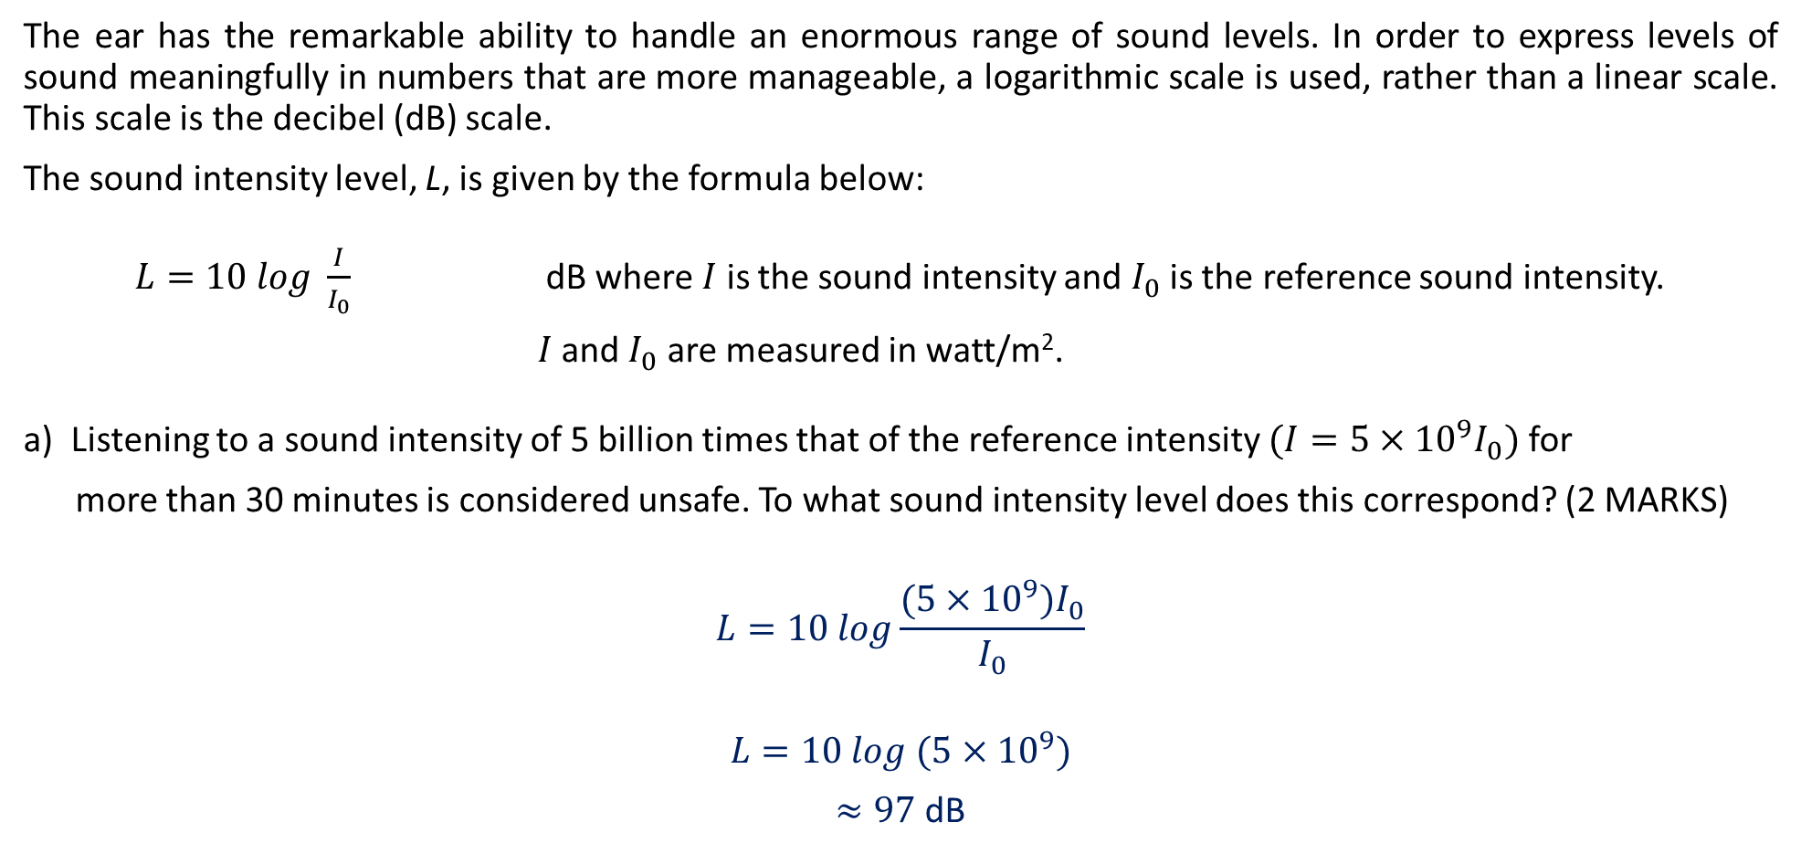
2018 WACE Calc-Assumed
The ear has the remarkable ability to handle an enormous range of sound levels. In order to express levels of sound meaningfully in numbers that are more manageable, a logarithmic scale is used, rather than a linear scale. This scale is the decibel (dB) scale.
The sound intensity level, L, is given by the formula below:
$L=10 log \frac{I}{I_{0}}$ dB where $I$ is the sound intensity and $I_{0}$ is the reference sound intensity.
$I$ and $I_{0}$ are measured in watt/m².
a) Listening to a sound intensity of 5 billion times that of the reference intensity $(I=5×{10}^{9}I_{0})$ for
more than 30 minutes is considered unsafe. To what sound intensity level does this correspond? (2 MARKS)
$$L=10 log\frac{(5×{10}^{9})I_{0}}{I_{0}}$$
$$L=10 log ({5×10}^{9})$$
$≈97$ dB
✓ Substitutes for L
✓ Calculates the intensity level

Slide 9

2018 WACE Calc-Assumed
b) The reference sound intensity, $I_{0}$, has a sound intensity level of 0 dB. If a household vacuum cleaner has a
sound intensity, $I=1×{10}^{−5}$ watt/m² and this corresponds to a sound intensity level $L=70$ dB,
determine $I_{0}$. (2 MARKS)
$$70=10 log\frac{(1×{10}^{−5}) }{I_{0}}$$
$$7=log\frac{({1×10}^{−5}) }{I_{0}}$$
$${10}^{7}=\frac{({1×10}^{−5}) }{I_{0}}$$
$I_{0}=\frac{({1×10}^{−5})}{{10}^{7}}={1×10}^{−12}$ watts/m²
✓ Substitutes for L and I
✓ Determines I₀ including units

Slide 10

2018 WACE Calc-Assumed
The average sound intensity level for rainfall is 50 dB and for heavy traffic 85 dB.
How many times more intense is the sound of traffic than that of rainfall? (3 MARKS)
$$50=10 log \frac{I_{rain}}{I_{0}}$$
${10}^{5}=\frac{I_{rain}}{I_{0}}$ $I_{rain}={10}^{5}I_{0}$
$$85=10 log \frac{I_{traffic}}{I_{0}}$$
${10}^{8.5}=\frac{I_{traffic}}{I_{0}}$ $I_{traffic}={10}^{8.5}I_{0}$
$$\frac{I_{traffic}}{I_{rain}}=\frac{{10}^{8.5}I_{0}}{{10}^{5}I_{0}}={10}^{3.5}≈3200$$
✓ Rearranges logs to exponentials
✓ Writes ratio and cancels I₀
✓ Determines how many more times
intense

Slide 11
2019 WACE Calc-Assumed (Q17 - 15 marks)
A microbiologist is studying the effect of temperature on the growth of a certain type of bacteria under controlled laboratory conditions. A population of bacteria is incubated at a temperature of 30 °C and the size of the population measured at hourly intervals for six hours. The logarithm of the population size appears to lie on a straight line when plotted against time (measured in hours) and the line of best fit shown on the axes below.
i. On the basis of the graph to the left, what is the size of the population after 2 hours? (2 MARKS)
ii. The equation of the line can be written in the form
log₁₀(P) = At + B.
Use the graph to determine the values of A and B. (2 MARKS)

Slide 12

2019 WACE Calc-Assumed
i. On the basis of the graph to the left, what is the size of the population after 2 hours?
Notice at $t=2$, $\log_{10}\left(P\right)=3$
${10}^{3}=P$
$P=1000$ (the population after 2 hours).
ii. The equation of the line can be written in the form log₁₀(P) = At + B.
Use the graph to determine the values of A and B.
The gradient is 0.5 and the y-intercept is at 2.
$$\log_{10}\left(P\right)=0.5t+2$$
✓ Identifies the correct value of log₁₀(P)
✓ Uses the inverse relationship between log₁₀(x) and
10^{x} to solve for P
✓ Determines the correct value for A
✓ Determines the correct value for B

Slide 13

2019 WACE Calc-Assumed
Another population of the same bacteria is cultured at 40°C. The size of the population, 𝑃, after 𝑡 hours satisfies the equation:
$$\log_{10}\left(P\right)=\frac{1}{3}t+2$$
i. Express the above equation in the form $P=A(10)^{Bt}$(3 MARKS)
ii. Determine the size of the population after exactly four hours to the nearest whole number. (1 MARK)
iii. Express the above equation in the form $t=C log_{10}\left(\frac{P}{D}\right)$ (3 MARKS)
iv. How many minutes does it take for the population to reach a size of 5000? Give your answer to the nearest minute. (2 MARKS)
c) With reference to parts a) and b), describe the effect of temperature on the population growth of this type of bacteria. (2 MARKS)

Slide 14

2019 WACE Calc-Assumed
Another population of the same bacteria is cultured at 40°C. The size of the population, 𝑃, after 𝑡 hours satisfies the equation:
$$\log_{10}\left(P\right)=\frac{1}{3}t+2$$
i. Express the above equation in the form $P=A(10)^{Bt}$
$${10}^{\frac{1}{3}t+2}=P$$
$${10}^{\frac{1}{3}t}×10^{2}=P$$
$$P=100(10)^{\frac{1}{3}t}$$
✓ Uses the inverse relationship between log₁₀(x) and 10^{x}
✓ Uses the appropriate index law
✓ Determines the correct expression

Slide 15

2019 WACE Calc-Assumed
Another population of the same bacteria is cultured at 40°C. The size of the population, 𝑃, after 𝑡 hours satisfies the equation:
$$\log_{10}\left(P\right)=\frac{1}{3}t+2$$
ii. Determine the size of the population after exactly four hours to the nearest whole number.
$$P=100(10)^{\frac{1}{3}\left(4\right)}$$
$$P≈2154$$
✓ Evaluates the population rounded to a whole number

Slide 16

2019 WACE Calc-Assumed
Another population of the same bacteria is cultured at 40°C. The size of the population, 𝑃, after 𝑡 hours satisfies the equation:
$$\log_{10}\left(P\right)=\frac{1}{3}t+2$$
iii. Express the above equation in the form $t=C log_{10}\left(\frac{P}{D}\right)$
$$\log_{10}\left(P\right)−2=\frac{1}{3}t$$
$$\log_{10}\left(P\right)−log_{10}100=\frac{1}{3}t$$
$$\log_{10}\left(\frac{P}{100}\right)=\frac{1}{3}t$$
$$t=3 \log_{10}\frac{P}{100}$$
✓ Expresses 2 in terms of a log of base 10
✓ Applies appropriate log law to arrive at single log expression (second last line)
✓ Determines the correct expression

Slide 17

2019 WACE Calc-Assumed
Another population of the same bacteria is cultured at 40°C. The size of the population, 𝑃, after 𝑡 hours satisfies the equation:
$$\log_{10}\left(P\right)=\frac{1}{3}t+2$$
iv. How many minutes does it take for the population to reach a size of 5000? Give your answer to the nearest minute.
$$t=3 \log_{10}\frac{5000}{100}$$
$t≈5.0969$hours
$t≈306$ minutes
✓ Evaluates the time in hours
✓ Converts to minutes (rounded to the nearest minute)

Slide 18

2019 WACE Calc-Assumed
Another population of the same bacteria is cultured at 40°C. The size of the population, 𝑃, after 𝑡 hours satisfies the equation:
$$\log_{10}\left(P\right)=\frac{1}{3}t+2$$
c) With reference to parts a) and b), describe the effect of temperature on the population growth of this type of bacteria.
The equation at 30 degrees has a greater slope than that of the 40 degree equation which indicates a greater growth rate. Parts a) and b) would seem to indicate that the lower temperature incubation results in a higher growth rate.
✓ Identifies the features of the equations in parts a) and b) that relate to growth
✓ States the lower temperature has higher growth

Slide 19
Independent Practice
Complete Ex 2I

